Slide 1
Customer Retention analysis
-Puram Nagaraju Internship-23

Slide 2
Introduction
Customer retention is a strategic process to keep or retain the existing customers and not letting them to diverge or defect to other suppliers or organization for business and this is only possible when there is a quality relationship between customer and supplier.
There are 5 major factors that contributed to the success of an e-commerce store have been identified as: service quality, system quality, information quality, trust and net benefit. The research furthermore investigated the factors that influence the online customers repeat purchase intention.
Five major factors that contributed to the success of an e-commerce store have been identified as: service quality, system quality, information quality, trust and net benefit. The research furthermore investigated the factors that influence the online customers repeat purchase intention.

Slide 3
Inbox
Problem statement
Introduction to "Customer retention"
Advantages of "Customer retention"
Problem understanding
Libraries and data collection
Graphical visualization
Limitations and scope for the future
Assumption
Conclusion

Slide 4
Problem Statement
Customer satisfaction has emerged as one of the most important factors that guarantee the success of online store; it has been posited as a key stimulant of purchase, repurchase intentions and customer loyalty. A comprehensive review of the literature, theories and models have been carried out to propose the models for customer activation and customer retention. Five major factors that contributed to the success of an e-commerce store have been identified as: service quality, system quality, information quality, trust and net benefit. The research furthermore investigated the factors that influence the online customers repeat purchase intention. The combination of both utilitarian value and hedonistic values are needed to affect the repeat purchase intention (loyalty) positively.

Slide 5
Customer retention
The customer retention definition in marketing is the process of engaging existing customers to continue buying products or services from your business.
Customer retention is a metric that measures customer loyalty, or the ability for an organization to keep its customers overtime. In addition to identifying the number of loyal customers, customer retention can reflect or predict customer satisfaction, repurchase behavior, customer engagement and emotional ties to a brand.
The measurement of customer retention should distinguish between behavioral intentions and actual customer behaviors.
The use of behavioral intentions as an indicator of customer retention is based on the premise that intentions are a strong predictor of future behaviors, such that customers who express a stronger repurchase intention toward a brand or firm will also exhibit stronger corresponding behaviors.

Slide 6
Advantages
Retention is Cheaper than Acquisition
Loyal Customers are More Profitable
Brand Will Stand Out from the Crowd
Earn More Word of Mouth Referrals
Customers Will Explore Your Brand
Loyal Customers are More Forgiving
Engaged Customers Provide More Feedback
Customers Will Welcome Your Marketing

Slide 7
Problem understanding
Customer retention means the process of maintaining or keeping customers once you have acquired them. It’s all the activities that a company must do in order to keep their customers around.
The goal is to build a long-lasting relationship between the brand and consumers.
Once a customer becomes loyal to yo ur brand, not only he will buy more from you than a normal customer but he’ll spread good words about your business, increase your reputation.
Here we have to analyse the affect of different feature on customer retention.

Slide 8
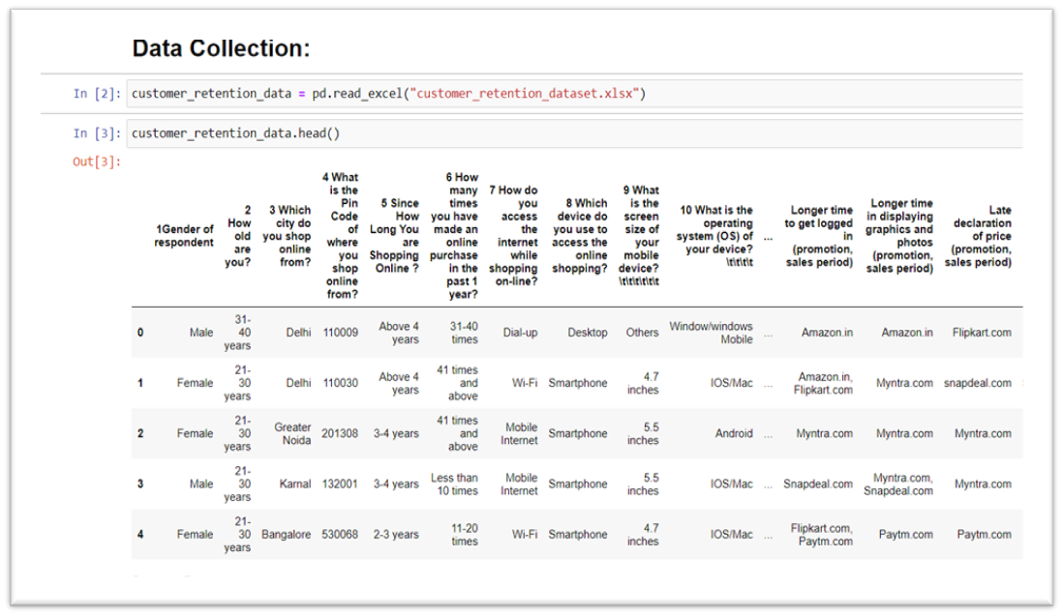
Libraries and data collection
These libraries are required to import the data
import pandas as pd
import numpy as np
import seaborn as sns
import maplotlib.pyplot as plt

Slide 9
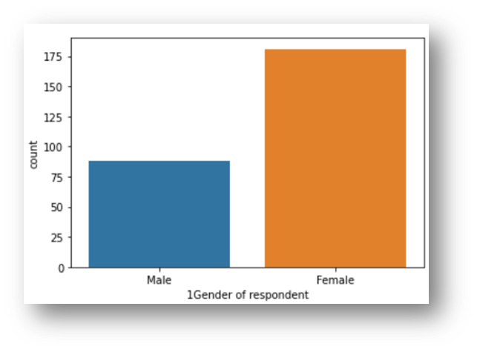
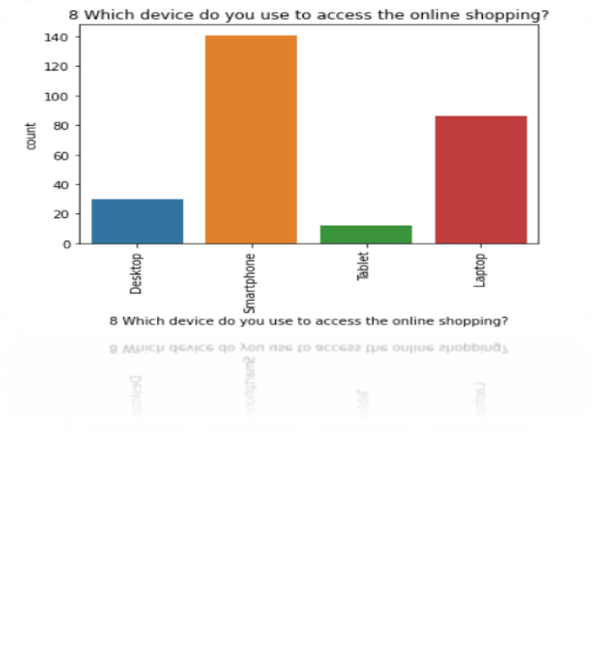
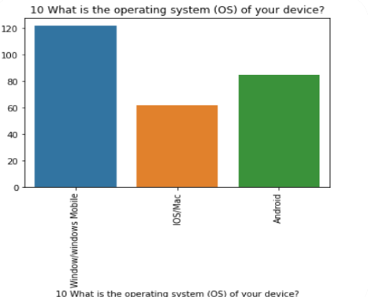
Graphical Visualization
Univariate analysis

Slide 10
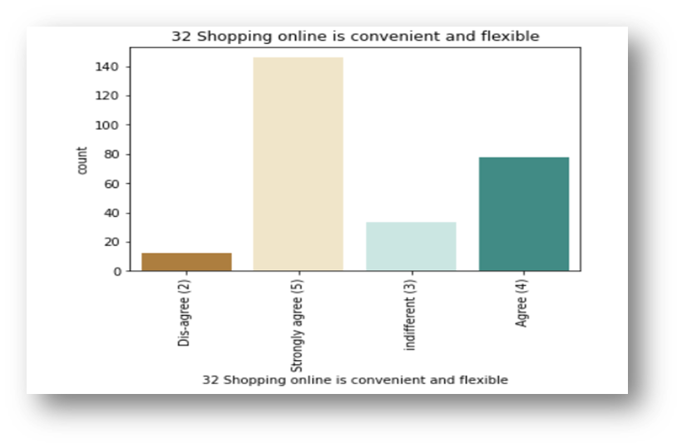
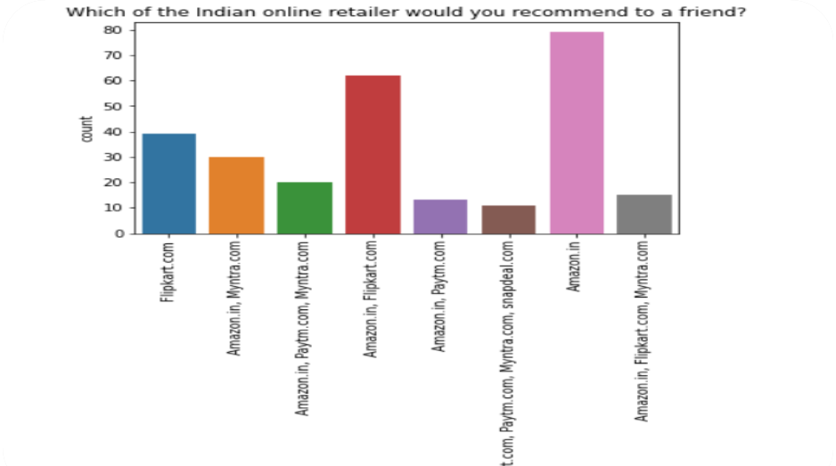
GRAPHICAL VISUALIZATION

Slide 11
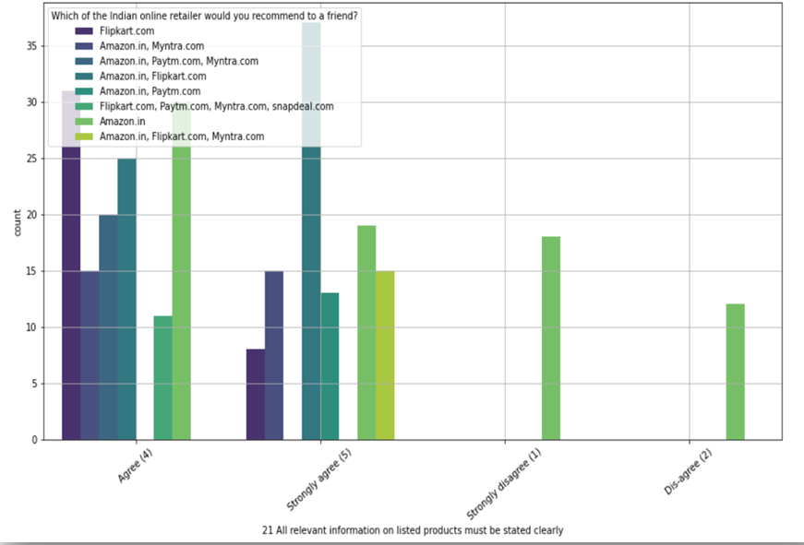
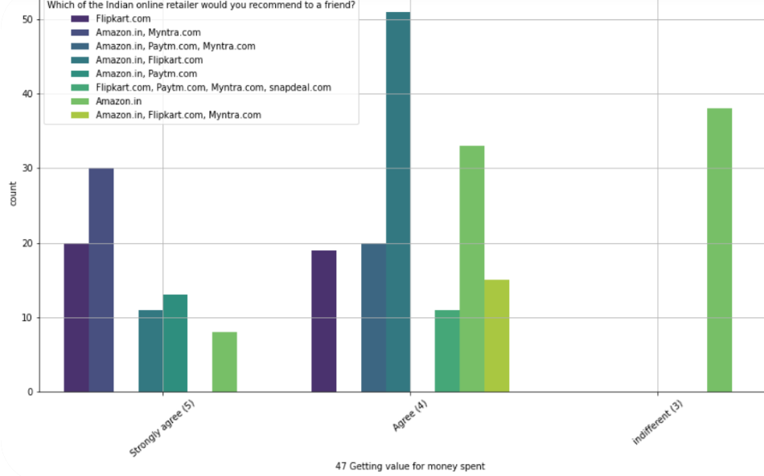
Bivariate Analysis

Slide 12
Assumptions
INitially we assumed that customers recommend e-commerce websites to their friends, if they are satisfied with the service and they are frequently using the websites for online shopping.
In order to prove that the customer expectations on an e-commerce website should influence the websites they recommend to their friends.
This implies that the websites recommended to their friends should meet the customer expectation and it is highly likely to be re-visited by the buyers for future purchases.
This hypothesis proves that the buyer who recommends a e-commerce site to a friend is the retained buyer of the respective e-commerce companies.

Slide 13
Limitations And Scope for the Future
The data used to analyze the customer retention was very less
The answers towards the e-commerce sites were combination of two or more e-commerce sites, the survey answers should have been limited to maximum 2 websites in order to understand the retention rates better.
It would have been beneficial to include a question asking that “ which website would you purchase from again”

Slide 14
Conclusion
As per our analysis, I can say that the companies with highest retention and customer satisfaction rates are amazon.In and flipkart.Com because their positives are line with the buyer preferences and they are most likely to use these websites for purchases in future.
The company with moderate retention rate is myntra.Com further, the company with very low retention rate and customer satisfaction is with paytm and snapdeal because most of the factors are not in line with the customer preferences and they are less likely to use this website again for online purchases.
Customer satisfaction plays a major role in retention, A company should first understand what customers expects while purchasing online (e-commerce) and build a better buying experience which will in turn retain the customer. An unforgettable experience is what drivers customers to buy again and again.

Slide 15
Thank you !!

